Slide 1
Chapter 2
Analysis of Continuous
Time Signals & Systems

Slide 2
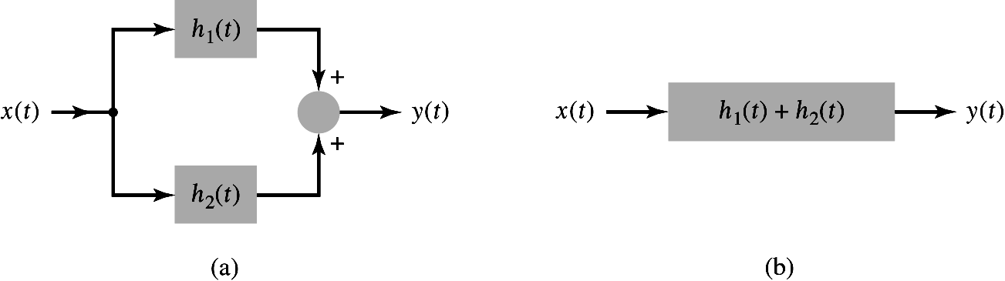
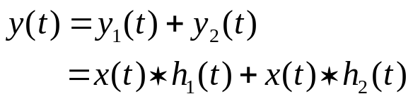
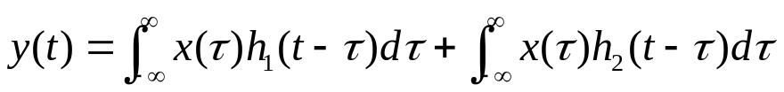
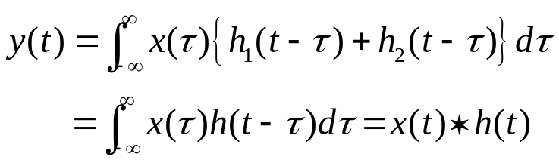
Time-Domain Representations of LTI Systems
Interconnection of LTI Systems
Interconnection of two LTI systems. (a) Parallel connection of two systems. (b) Equivalent system.
Parallel Connection of LTI Systems
1. Two LTI systems:
2. Output:
where h(t) = h₁(t) + h₂(t)

Slide 3
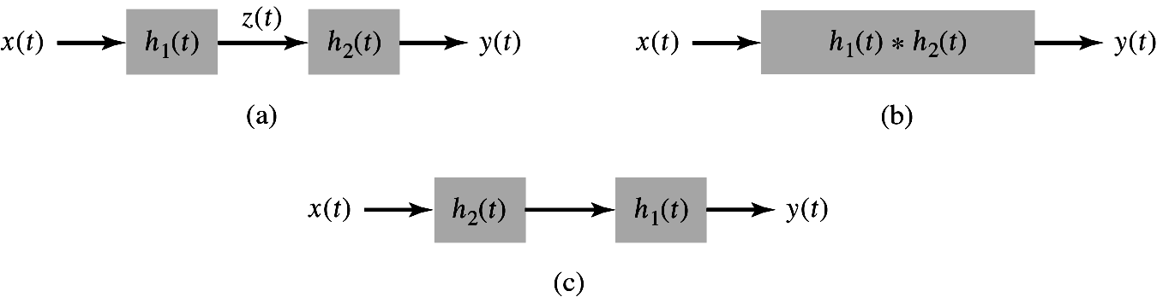
Time-Domain Representations of LTI Systems
♣ Distributive property for Continuous-time case:
♣ Distributive property for Discrete-time case:
Cascade Connection of LTI Systems
1. Two LTI systems:
Interconnection of two LTI systems. (a) Cascade connection of two systems. (b) Equivalent system. (c) Equivalent system: Interchange system order.

Slide 4

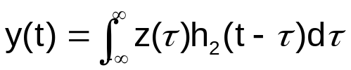
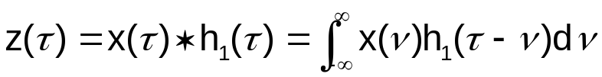
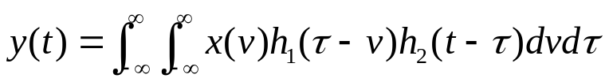
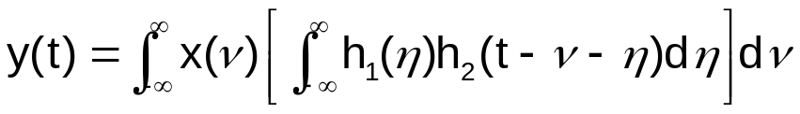
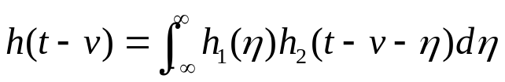
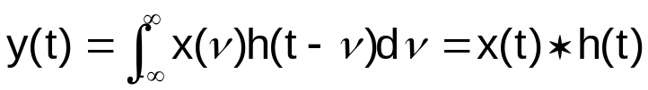
Time-Domain Representations of LTI Systems
2. The output is expressed in terms of z(t) as
Since z(t) is the output of the first system, so it can be expressed as
Substituting Eq. 2 for z(t) into Eq. 1 gives
Change of variable
η = τ − ν
Define h(t) = h₁(t) ∗ h₂(t), then
Fig. 2.19(b).
3. Associative property for continuous-time case:

Slide 5
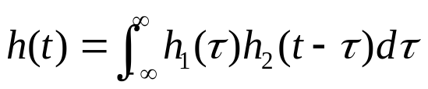
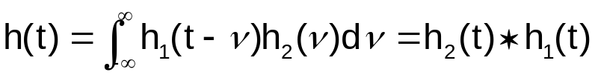



Time-Domain Representations of LTI Systems
4. Commutative property:
Write h(t) = h₁(t) ∗ h₂(t) as the integral
Change of variable
ν = t − τ
Interchanging the order of the LTI systems in the cascade without affecting the result:
Commutative property for continuous-time case:
5. Associative property for discrete-time case:
Commutative property for discrete-time case:

Slide 6




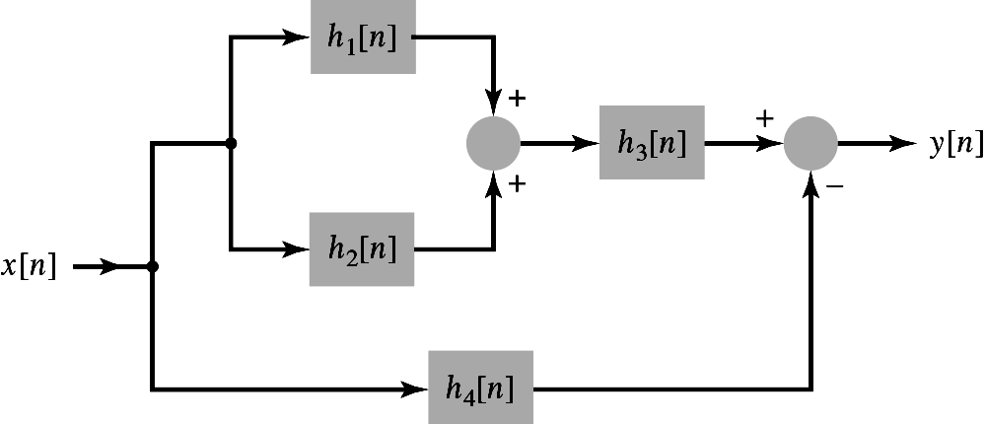
Time-Domain Representations of LTI Systems
Example 2.11 Equivalent System to Four Interconnected Systems
Consider the interconnection of four LTI systems, as depicted in Fig. 2.20. The impulse responses of the systems are
and
Find the impulse response h[n] of the overall system.
Figure 2.20
(p. 131)
Interconnection of systems for Example 2.11.
<Sol.>
1. Parallel combination of h₁[n] and h₂[n]:
h₁₂[n] = h₁[n] + h₂[n]
Fig. 2.21 (a).

Slide 7
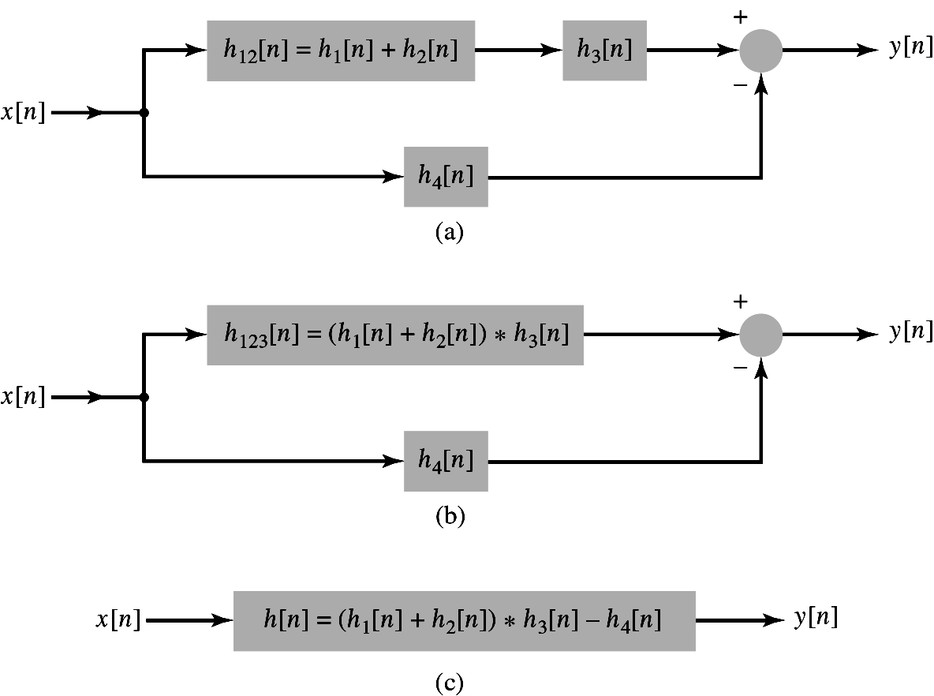
Time-Domain Representations of LTI Systems
Figure 2.21
(p. 131)
(a) Reduction of parallel combination of LTI systems in upper branch of Fig. 2.20. (b) Reduction of cascade of systems in upper branch of Fig. 2.21(a).
(c) Reduction of parallel combination of systems in Fig. 2.21(b) to obtain an
equivalent system for Fig. 2.20.

Slide 8

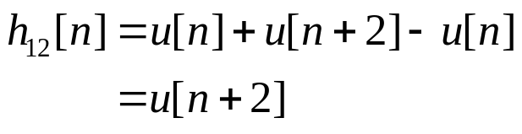
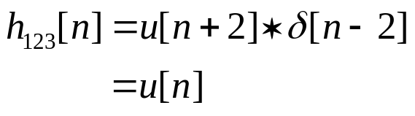

Time-Domain Representations of LTI Systems
2. h₁₂[n] is in series with h₃[n]:
h₁₂₃[n] = h₁₂[n] ∗ h₃[n]
h₁₂₃[n] = (h₁[n] + h₂[n]) ∗ h₃[n]
3. h₁₂₃[n] is in parallel with h₄[n]:
h[n] = h₁₂₃[n] − h₄[n]
Thus, substitute the specified forms of h₁[n] and h₂[n] to obtain
Convolving h₁₂[n] with h₃[n] gives
♣ Table 2.1 summarizes the interconnection properties presented in this section.

Slide 9

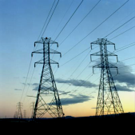
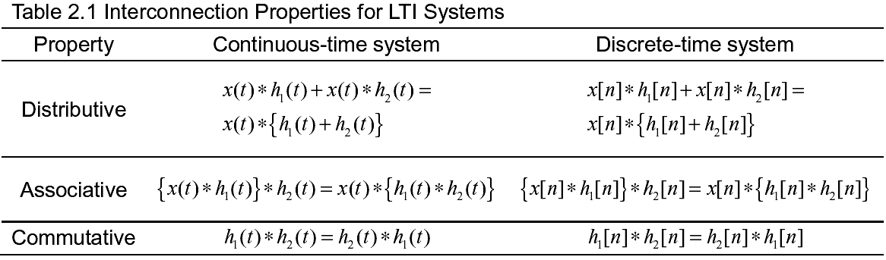
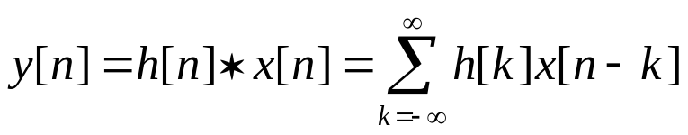
Time-Domain Representations of LTI Systems
2.7 Relation Between LTI System Properties and the
Impulse Response
2.7.1 Memoryless LTI Systems
1. The output of a discrete-time LTI system:
(2.27)

Slide 10

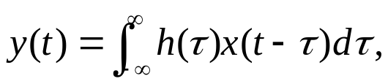

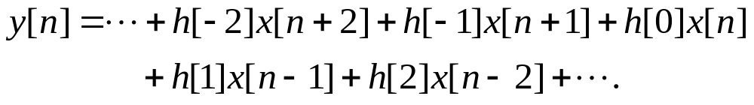
Time-Domain Representations of LTI Systems
2. To be memoryless, y[n] must depend only on x[n] and therefore cannot
depend on x[n − k] for k ≠ 0.
A discrete-time LTI system is memoryless if and only if
c is an arbitrary constant
♣ Continuous-time system:
1. Output:
2. A continuous-time LTI system is memoryless if and only if
c is an arbitrary constant
2.7.2 Causal LTI Systems
The output of a causal LTI system depends only on past or present values of the input.
♣ Discrete-time system:
1. Convolution sum:

Slide 11

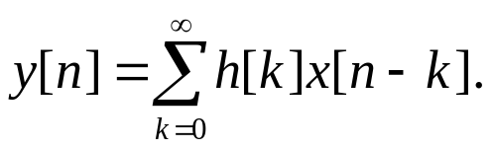
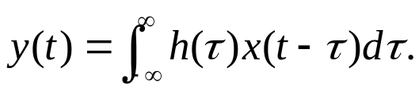




Time-Domain Representations of LTI Systems
2. For a discrete-time causal LTI system,
3. Convolution sum in new form:
♣ Continuous-time system:
1. Convolution integral:
3. Convolution integral in new form:
2. For a continuous-time causal LTI system,
2.7.3 Stable LTI Systems
A system is BIBO stable if the output is guaranteed to be bounded for every bounded input.
♣ Discrete-time case: Input
Output:

Slide 12
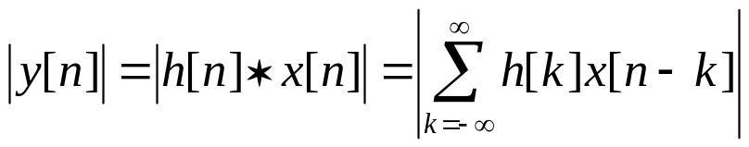
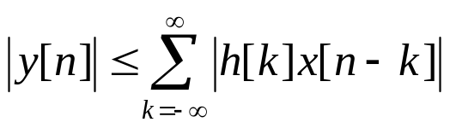

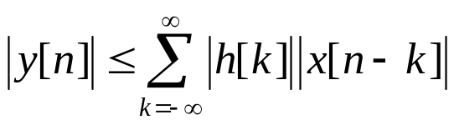


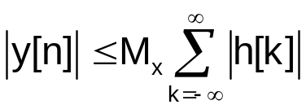
Time-Domain Representations of LTI Systems
1. The magnitude of output:
2. Assume that the input is bounded, i.e.,
and it follows that
(2.28)
Hence, the output is bounded, or |y[n]| ≤ ∞ for all n, provided that the impulse response of the system is absolutely summable.
3. Condition for impulse response of a stable discrete-time LTI system:

Slide 13
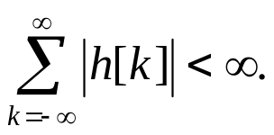
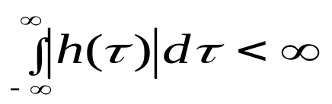


Time-Domain Representations of LTI Systems
♣ Continuous-time case:
Condition for impulse response of a stable continuous-time LTI system:
Example 2.12 Properties of the First-Order Recursive System
The first-order system is described by the difference equation
and has the impulse response
Is this system causal, memoryless, and BIBO stable?
<Sol.>
1. The system is causal, since h[n] = 0 for n < 0.
2. The system is not memoryless, since h[n] ≠ 0 for n > 0.
3. Stability: Checking whether the impulse response is absolutely summable?

Slide 14
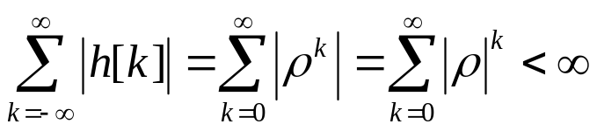
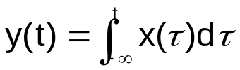
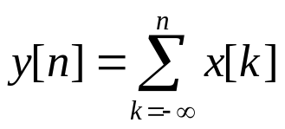
Time-Domain Representations of LTI Systems
if and only if |ρ| < 1
◆ Note:
A system can be unstable even though the impulse response has a finite value.
1. Ideal integrator:
(2.29)
Input: x(τ) = δ (τ), then the output is y(t) = h(t) = u(t).
h(t) is not absolutely integrable
Ideal integrator is not stable!
2. Ideal accumulator:
Impulse response: h[n] = u[n]
h[n] is not absolutely summable
Ideal accumulator is not stable!

Slide 15




Time-Domain Representations of LTI Systems
2.7.4 Invertible Systems and Deconvolution
A system is invertible if the input to the system can be recovered from the output except for a constant scale factor.
1. h(t) = impulse response of LTI system,
2. h^{inv}(t) = impulse response of LTI inverse system
Fig. 2.24.
Figure 2.24 (p. 137)
Cascade of LTI system with impulse response h(t) and inverse system with impulse response h⁻¹(t).
3. The process of recovering x(t) from h(t) ∗ x(t) is termed deconvolution.
4. An inverse system performs deconvolution.
Continuous-time case
(2.30)
5. Discrete-time case:
(2.31)

Slide 16

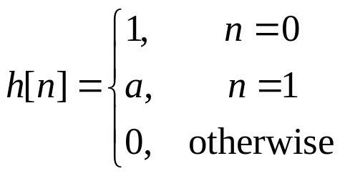

Time-Domain Representations of LTI Systems
Example 2.13 Multipath Communication Channels: Compensation by means of
an Inverse System
Consider designing a discrete-time inverse system to eliminate the distortion associated with multipath propagation in a data transmission problem. Assume that a discrete-time model for a two-path communication channel is
Find a causal inverse system that recovers x[n] from y[n]. Check whether this inverse system is stable.
<Sol.>
1. Impulse response:
2. The inverse system h^{inv}[n] must satisfy h[n] ∗ h^{inv}[n] = δ[n].
(2.32)
For n < 0, we must have h^{inv}[n] = 0 in order to obtain a causal inverse
system

Slide 17



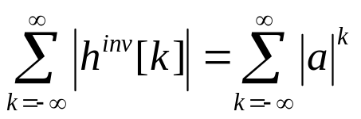
Time-Domain Representations of LTI Systems
2) For n = 0, δ[n] = 1, and eq. (2.32) implies that
(2.33)
3. Since h^{inv}[0] = 1, Eq. (2.33) implies that h^{inv}[1] = − a, h^{inv}[2] = a², h^{inv}[3] = − a³,
and so on.
The inverse system has the impulse response
4. To check for stability, we determine whether h^{inv}[n] is absolutely summable,
which will be the case if
is finite.
♣ For |a| < 1, the system is stable.
★ Table 2.2 summarizes the relation between LTI system properties and
impulse response characteristics.

Slide 18
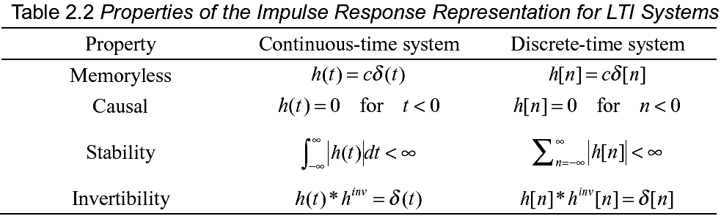
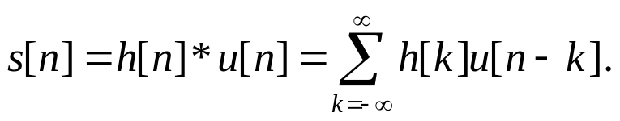
Time-Domain Representations of LTI Systems
2.8 Step Response
1. The step response is defined as the output due to a unit step input signal.
2. Discrete-time LTI system:
Let h[n] = impulse response and s[n] = step response.
3. Since u[n − k] = 0 for k > n and u[n − k] = 1 for k ≤ n, we have

Slide 19
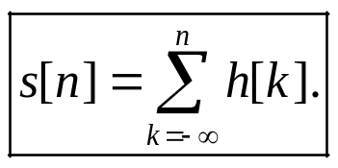
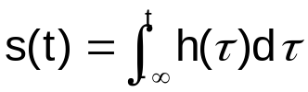
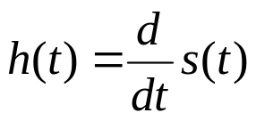

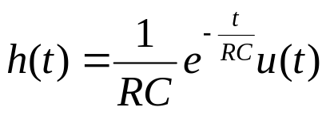
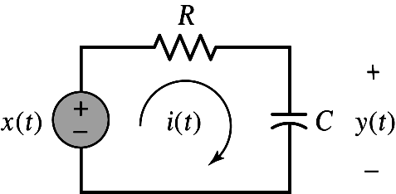
Time-Domain Representations of LTI Systems
The step response is the running sum of the impulse response.
♣ Continuous-time LTI system:
(2.34)
The step response s(t) is the running integral of the impulse response h(t).
◆ Express the impulse response in terms of the step response as
and
Figure 2.12
(p. 119)
RC circuit system with the voltage source x(t) as input and the voltage measured across the capacitor y(t), as output.
Example 2.14 RC Circuit: Step Response
The impulse response of the RC circuit depicted in Fig. 2.12 is
Find the step response of the circuit.
<Sol.>

Slide 20
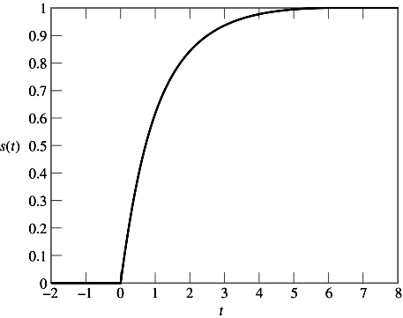
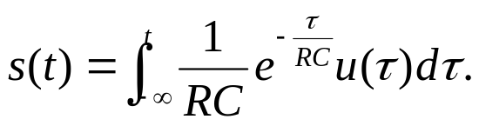
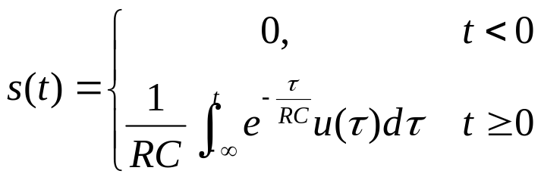
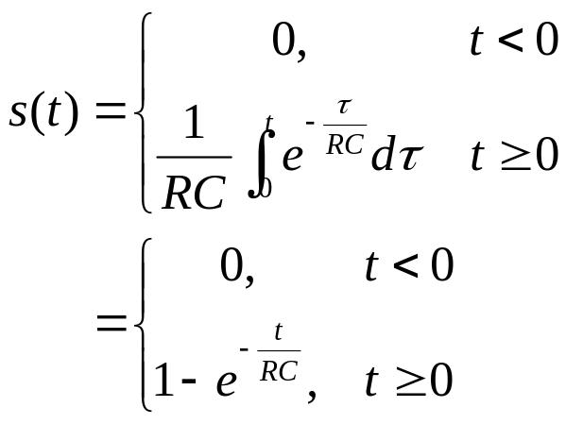
Time-Domain Representations of LTI Systems
CHAPTER
2
1. Step response:
Figure 2.25 (p. 140)
RC circuit step response for RC = 1 s.
Fig. 2.25

Slide 21
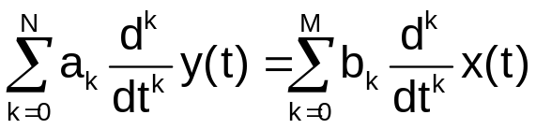
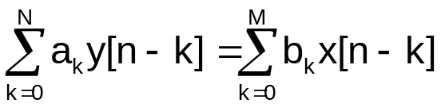
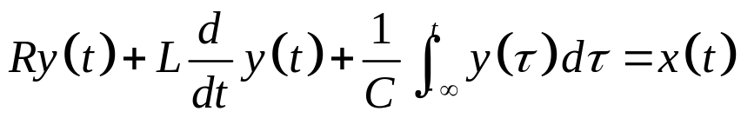
Time-Domain Representations of LTI Systems
Differential and Difference Equation Representations of
LTI Systems
1. Linear constant-coefficient differential equation:
Input = x(t), output = y(t)
(2.35)
2. Linear constant-coefficient difference equation:
Input = x[n], output = y[n]
(2.36)
♣ The order of the differential or difference equation is (N, M), representing the
number of energy storage devices in the system.
Ex. RLC circuit.
Often, N ≥ M, and the order is described using only N.
1. Input = voltage source x(t), output = loop current
2. KVL Eq.:

Slide 22
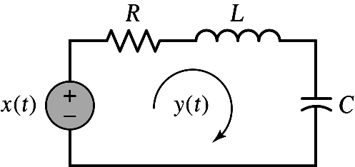

Time-Domain Representations of LTI Systems
Figure 2.26 (p. 141)
Example of an RLC circuit described by a differential equation.
N = 2

Slide 23



Time-Domain Representations of LTI Systems
Ex. Second-order difference equation:
N = 2
♣ Difference equations are easily rearranged to obtain recursive formulas for
computing the current output of the system from the input signal and the
past outputs.
Ex. Eq. (2.36) can be rewritten as
Ex. Consider computing y[n] for n ≥ 0 from x[n] for the second-order difference
equation (2.37).
<Sol.>
1. Eq. (2.37) can be rewritten as
2. Computing y[n] for n ≥ 0:

Slide 24






Time-Domain Representations of LTI Systems
(2.39)
(2.40)
♣ Initial conditions: y[ − 1] and y[ − 2].
◆ The initial conditions for Nth-order difference equation are the N values
◆ The initial conditions for Nth-order differential equation are the N values

Slide 25


Time-Domain Representations of LTI Systems
Example 2.15 Recursive Evaluation of a Difference Equation
Find the first two output values y[0] and y[1] for the system described by Eq. (2.38), assuming that the input is x[n] = (1/2)^{n}u[n] and the initial conditions are y[ − 1] = 1 and y[ − 2] = − 2.
<Sol.>
1. Substitute the appropriate values into Eq. (2.39) to obtain
2. Substitute for y[0] in Eq. (2.40) to find

Slide 26






Time-Domain Representations of LTI Systems
2.10 Solving Differential and Difference Equations
Complete solution: y = y ^{(h)} + y ^{(p)}
y ^{(h)} = homogeneous solution,
y ^{(p)} = particular solution
2.10.1 The Homogeneous Solution
♣ Continuous-time case:
1. Homogeneous differential equation:
2. Homogeneous solution:
Coefficients c_{i} is determined by I.C.
(2.41)
3. Characteristic eq.:
(2.42)
♣ Discrete-time case:
1. Homogeneous differential equation:
2. Homogeneous solution:
Coefficients c_{i} is determined by I.C.
(2.43)
3. Characteristic eq.:
(2.44)

